Slide 1


REPUBLIC OF CAMEROON PEACE - WORK – FATHERLAND MINISTRY OF HIGHER EDUCATION
REPUBIQUE DU CAMEROUN PAIX – TRAVAIL – PATRIE MINISTERE DE L'ENSEIGNEMENT SUPERIEUR
UNIVERSITY OF BAMENDA HIBMAT BUEA
SCHOOL OF ENGINEERING AND TECHNOLOGY DEPARTMENT OF COMPUTER AND COMMUNICATIONS ENGINEERING
IMPLEMENTATION OF SPEECH RECOGNITION ON A PYTHON BASED SMART VIRTUAL ASSISTANT
Submitted to the University of Bamenda in partial fulfillment for the requirement for the award of the Bachelor of Technology (BTech) in Software Engineering
BY
NJI NGENGE BLESS
(1038/UBa/B-tech/CENG/21)
SUPERVISOR
Mr. OLOUGE SAMSON
AUGUST 2022

Slide 2
Content
Introduction
Literature Review
Research Methodology
Results
Limitations/Challenges
Recommendation
Conclusion

Slide 3
Introduction
Problem statement
In a world where everything is digitalized and everyone is focused on trying to do things as fast as possible, it is important to stay ahead of technology. The use of speech commands to control our computers is a trending subject today and is proving to be very useful and to become even more useful in the future. Although the idea of voice command has been there for a while, it is a new technology in our society. Its many benefits and help are being missed by users. To some extent even some certain groups of underprivileged like the handicapped e.g. armless and blind are missing out on these benefits as well. Not forgetting that most of our virtual assistants work mostly online. It is therefore made imperative that this study demonstrate and expose the technicalities and beauty of this field to our societies, which are indeed in need of such systems but oftentimes are void of the knowledge about even the very use or existence of the field or the benefits it offers.

Slide 4
Introduction Continues
In today’s era almost all tasks are digitalized. We have Smartphone in hands and it is nothing less than having world at your fingertips. These days we aren’t even using fingers. We just speak of the task and it is done. There exist systems where we can say Text Dad, “I’ll be late today.” And the text is sent. That is the task of a Virtual Assistant
In this study, we seek to give a brief introduction to software development as a whole, then move further to explaining the concepts of Speech recognition and the technology behind speech recognition and actually implement one on a virtual assistant built using the libraries in python.

Slide 5
Literature Review
Software Engineering
It is an engineering branch associated with the development of software product using well-defined scientific principles, methods and procedures. The outcome of software engineering is an efficient and reliable software product.
Agile Software Development
Agile methods are incremental development methods in which the increments are small and typically new releases of the system are created and made available to customers every two to three weeks.
The process of finding out, analyzing, documenting and checking these services and constraints is called requirement engineering.
System modeling is the process of developing abstract models of a system, with each model presenting a different view or perspective for the system. System modeling has generally come to mean representing the system using some kind of graphical notations, which is now almost always based on notations of trhe Unified Modeling Language (UML).

Slide 6
Literature Review Continues
Speech Recognition
Speech recognition, or speech-to-text, is the ability of a machine or program to identify words spoken aloud and convert them into readable text.
Speech recognition has a few applications. A sample of these are: Mobile devices, Education. Customer Service, Healthcare application, Disability assistance, Emotion recognition, hands-free communication.

Slide 7
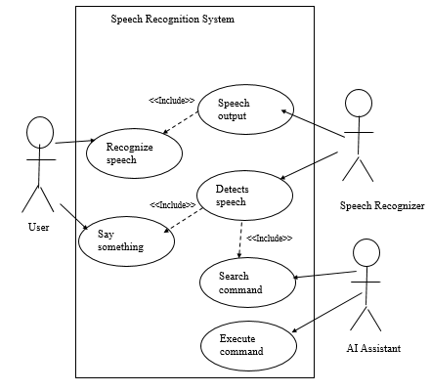
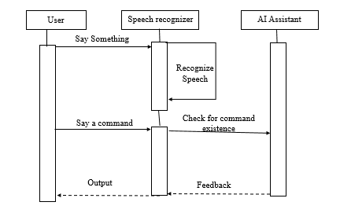
Research Methodology
Use case Diagram
Sequence diagram

Slide 8
The entire system used the following modules/packages for the system to be developed.
Model, KaldiRecognizer, Speech recognizer, pyttsx3, OS, Datetime, Webbrowser, Playsound, Wikipedia and more.
The Language/Framework/IDE version used are python 3.9.6, Visual studio code.

Slide 9
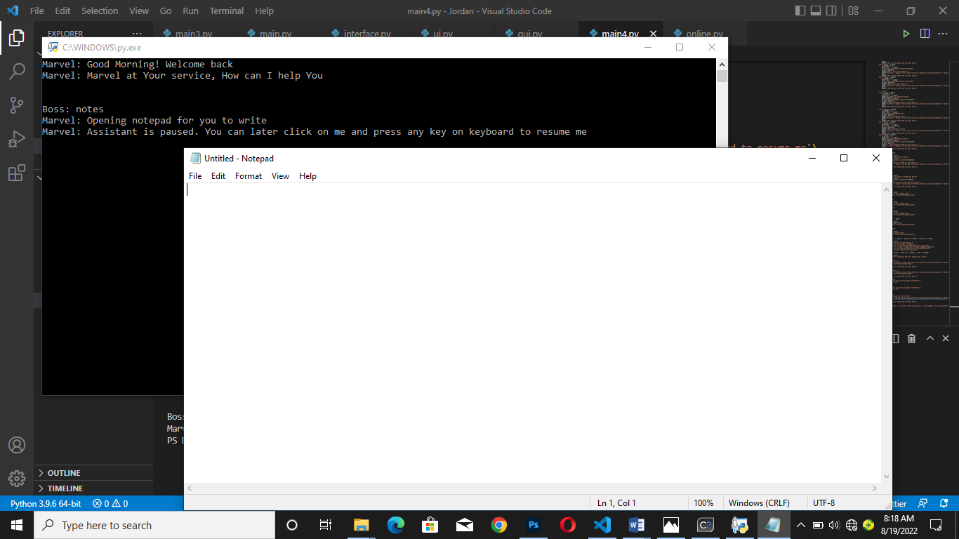
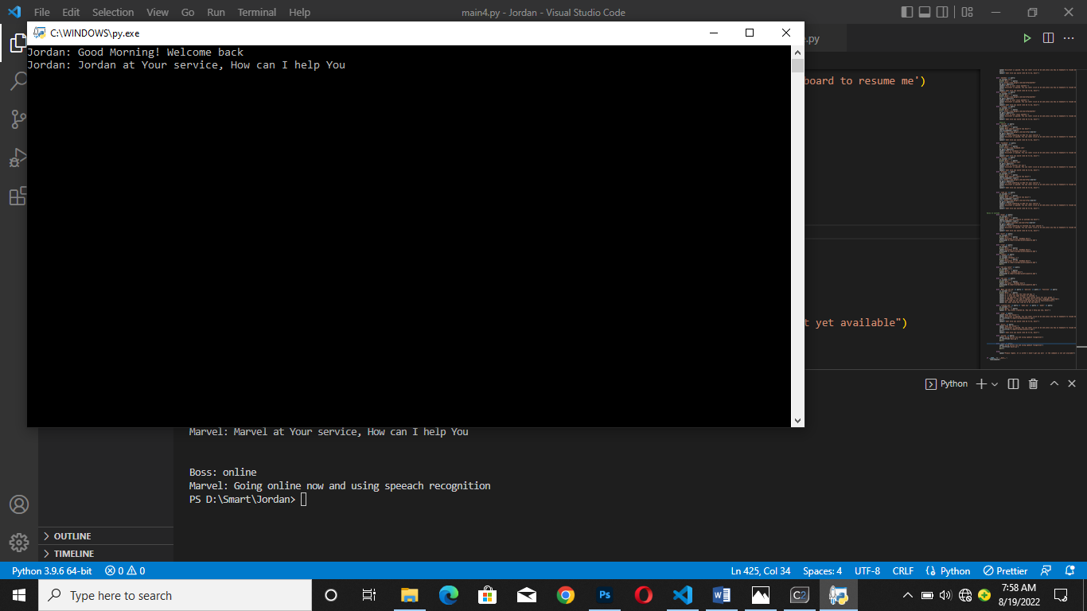
Results
Assistant on Execution
Assistant opening notepad after listening to command

Slide 10
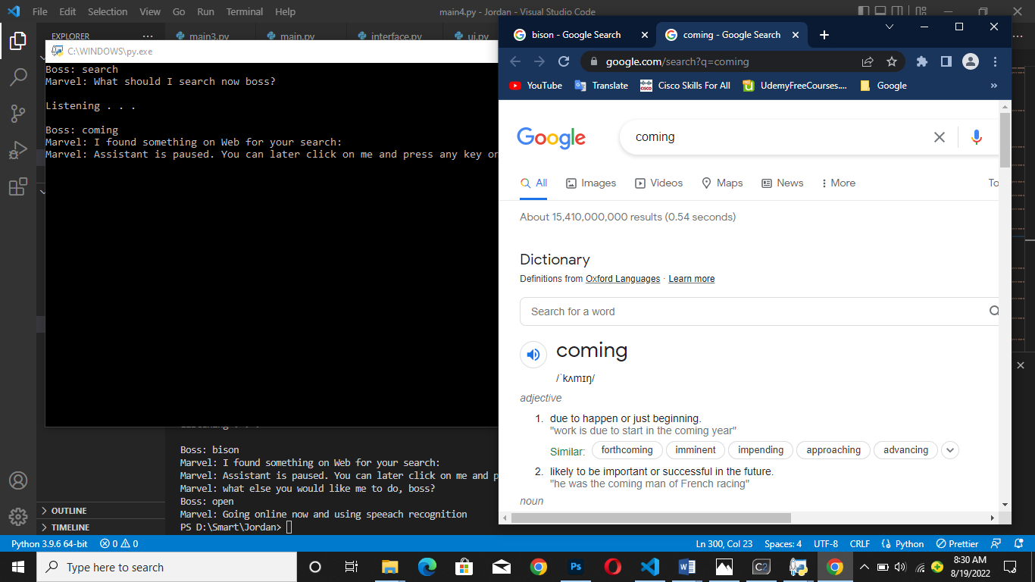
Results
Assistant performing search on google

Slide 11
Limitations/Challenges
One difficulty I faced was using the Vosk KaldiRecognizer. Since it’s accuracy in predicting words was low, words were to be spoken very accurately.

Slide 12
Recommendation
I would love to recommend that:
I must recommend that many students should take projects and research activities in the field of Artificial Intelligence and at also take a look at implementations of speech recogniton.
Students should consider taking much time to have a good understanding of the subject and it’s feasibility before implementaion,
Students should look for real life problems in our local societies and find AI related solutions to them

Slide 13
Conclusion
The project activity was overly exciting and challenging and educative as well. I am filled with excitement to have realized the project this far. As the principle of software evolution implies though, it is made eminent that this project is not done and dusted. It will continue to be modified and made to become better. Keeping learning at the focus of the entire process but as well being fun, challenging and very beneficial, I am happy I chose this path.

Slide 14
THANK YOU

